Slide 1
Introduction to my Career and Seminar
Dr. Abdellatif Sadeq
17/04/2023

Slide 2
Outline
Personal Profile
Career Summary
Education
Employment History
Teaching Experience
Research Profile
Seminar
Introduction
Numerical Simulation Approach
Results and Discussions
Conclusions

Slide 3
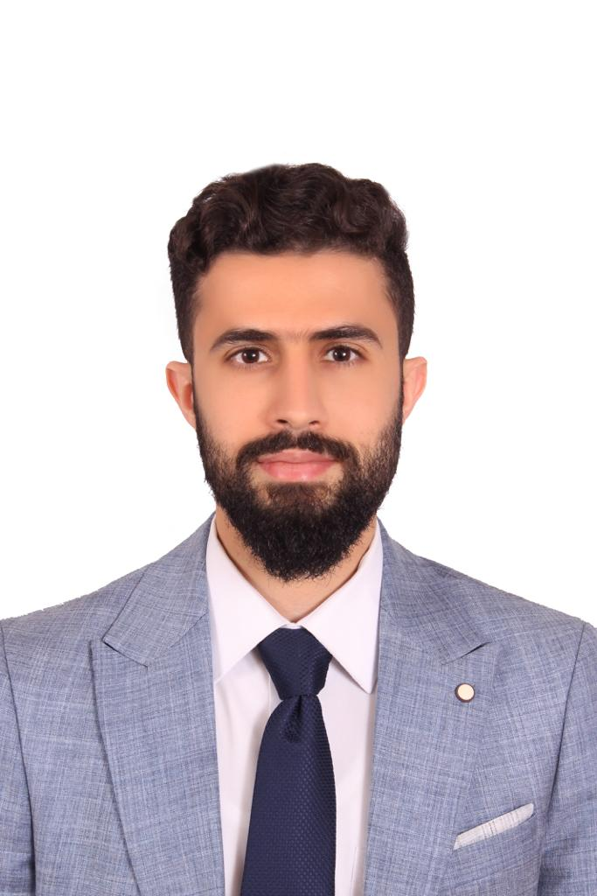
1. Personal Profile
Personal Information
Name: Dr. Abdellatif Mohammad Sadeq
Nationality: Jordanian
Data of Birth: 30/04/1993 (29 y.o.)
Languages: Arabic (mother tongue), English (Excellent)
Residency: Jordan (1993 to 1998), Qatar (1998 to 2023)
Status: Single
Phone: +974 33108689
Email: abboud1993@yahoo.com
LinkedIn Profile: Dr. Abdellatif Sadeq
Experience: +8 years in Teaching and Research at QU
Membership: ASHRAE, Review in IMDP, SCI, QU Alumini, and Elsevier Researcher Academy
Key Skills
Documentation: MS Word, Excel, PPT, Outlook, Grammarly, iThenticate, and Mendeley
Programming: C++, Python, MATLAB, Arduino, and R
Modeling and Simulation: AutoCAD, SOLIDWORKS, ANSYS Fluent, Mechanical APDL, Simulink, Simscape, CATIA V5, and Mathematica
Energy and Thermodynamic: EES, GASEQ, Thermtest, and Chemkin Pro
Data Analysis: SurveyMonkey, Simplybook, Blue Survey, and Google Form
Personal: Hard-Working, Problem Solving, Teamwork, Planning, and Deep Analysis

Slide 4
2. Career Summary
Career Summary
I have earned my B.Sc. (2015), M.Sc. (2018), and Ph.D. (2022) in mechanical engineering from Qatar University (QS-208). I have been working as a graduate teaching and research assistant at Qatar University since 2015. Presently, I have over eight years of experience teaching undergraduate students various general and mechanical engineering courses. My areas of expertise in research are internal combustion engines, premixed turbulent combustion, alternative fuels, fuel technology, hydrogen production and combustion, electric and hybrid electric vehicles, renewable energy utilization, heat transfer, and HVAC.

Slide 5
3. Education
Scientific Degrees
The General Secondary Education Certificate \ Scientific Section, Ahmed Bin Hanbal Secondary Ind. Boys School Public
2009 September - 2010 July Ranked in the top 10 students list in Qatar
B.Sc. in Mechanical Engineering, Qatar University
2011 February - 2015 January Awarded 7 distinction certificates (CGPA of 3.59/4.00)
M.Sc. in Mechanical Engineering, Qatar University
2015 September - 2018 January Awarded 4 honor certificates (CGPA of 3.68/4.00)
Ph.D. in Mechanical Engineering, Qatar University
2018 August - 2022 May Excellency Certificate in Ph.D. Program (CGPA of 3.77/4.00)
About to Receive a Second Master Degree in Hybrid and Electric Vehicles Design and Analysis
2022 July - 2023 June

Slide 6
4. Employment History
Positions
Research Assistant, Qatar University
2015 January - 2015 September
M.Sc. Graduate Teaching and Research Assistant, Qatar University
2015 September - 2018 January
Ph.D. Graduate Teaching and Research Assistant, Qatar University
2018 August – 2022 August

Slide 7
5. Teaching Experience
Positions
M.Sc. Graduate Assistant 2015 September - 2018 January
Ph.D. Graduate Assistant
2018 August - 2022 August
560 hours of teaching undergraduate students a variety of mechanical engineering courses
Supervised plenty of senior design projects
Assisted in teaching undergraduate students how to use designing and modelling software such as SOLIDWORKS, ANSYS Fluent, and AutoCAD
Participated in the preparation of many mechanical engineering workshops
920 hours of teaching different general and mechanical engineering courses
Prepared some engineering workshops such as elementary mathematics and introduction to MATLAB / CFD workshops
Worked in the college of engineering learning support center as a supervisor and a tutor
Coordination and Reporting for CENG learning support center
Supervised different senior design projects

Slide 8
5. Teaching Experience
Courses
Course ID | Course Name | Total Hours
General Engineering Courses
GENG 106 | Computer Programming | 21
GENG 107 | Engineering Ethics | 13
GENG 111 | Engineering Graphics | 21
GENG 200 | Probability and Statistics for Engineers | 42
GENG 231 | Material Science | 12
GENG 300 | Numerical Methods | 128
GENG 360 | Engineering Economics | 59
ELEC 201 | Electric Circuits I | 124
Mechanical Engineering Courses
MECH 223 | Solid Mechanics | 32
MECH 241 | Thermofluids | 254
MECH 321 | Mechanical Mechanisms | 42
MECH 342 | Thermodynamics | 180
MECH 343 | Fluid Mechanics | 170
MECH 344 | Heat Transfer | 74
MECH 361 | Control System | 21
MECH 447 | Heat Engines | 287

Slide 9
6. Research Profile
Profile
ResearchGate: https://www.researchgate.net/profile/Abdellatif-Sadeq
ORCID iD: 0000-0002-1825-0304
Google Scholar: https://scholar.google.com/citations?hl=en&user=dkkLKo0AAAAJ
Areas of Expertise:
Major Areas i) Internal combustion engines, ii) Premixed turbulent combustion, iii) Alternative fuels, iv) Fuel technology, v) Turbulence modelling, vi) EV/HEV vehicles design and analysis, vii) Heat transfer
Minor Areas
i) Hydrogen production and combustion, ii) Renewable energy utilization, iii) Sustainable development, iv) HVAC

Slide 10
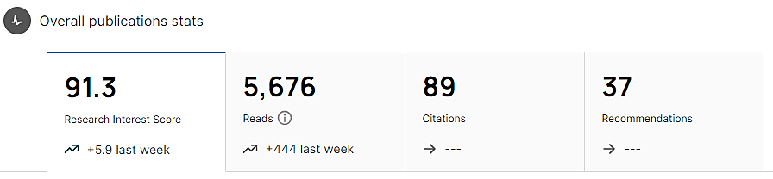
6. Research Profile
Profile
Statistics:
13 journal papers, 6 published, 4 under review and 3 under preparation
4 conference papers
19 projects, 2 books, 1 user manual, 1 method, 1 seminar, M.Sc. thesis and Ph.D. dissertation
as recorded in 17/04/2023

Slide 11
Seminar on
Transient 3D Simulations of Turbulent Premixed Flames of Gas-To-Liquid (GTL) Fuel in a Fan-Stirred Combustion Vessel
17/04/2023

Slide 12
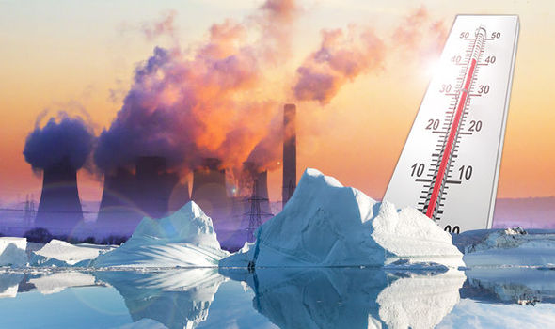
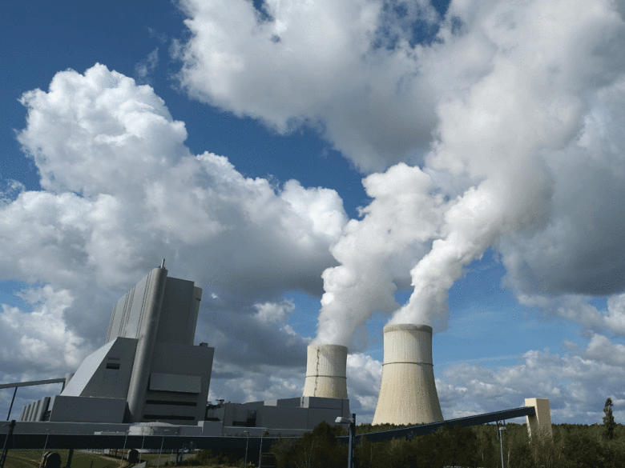
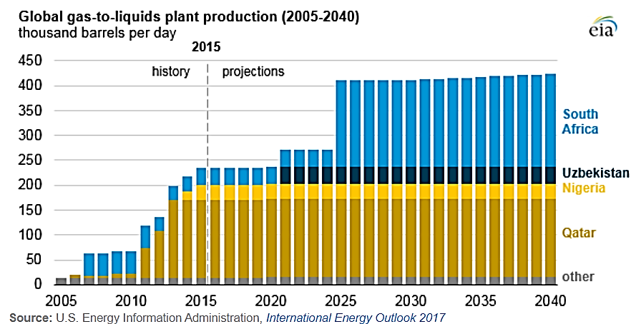
a. Introduction
Problem Statement
Global warming
Emission legislations
Continuous increase in oil prices
Demand for cleaner fuels
Demand for higher engine performance
Global warming effects
Global GTL plant production (2005-2040)

Slide 13
a. Introduction
Objective
Determine the optimum turbulence and thermodynamic operating conditions of GTL fuel (and its 50/50 blend with diesel) to assess its suitability for replacing diesel fuel.
Significance
The outcomes of this study can benefit researchers in different areas such as chemical kinetic mechanisms and flame extinction and diffusion.
Contribute to remarkable improvements in different energy sector such as oil and gas production and renewable energy sectors.
Validate and compare different turbulence models and experimental data obtained from other techniques.

Slide 14
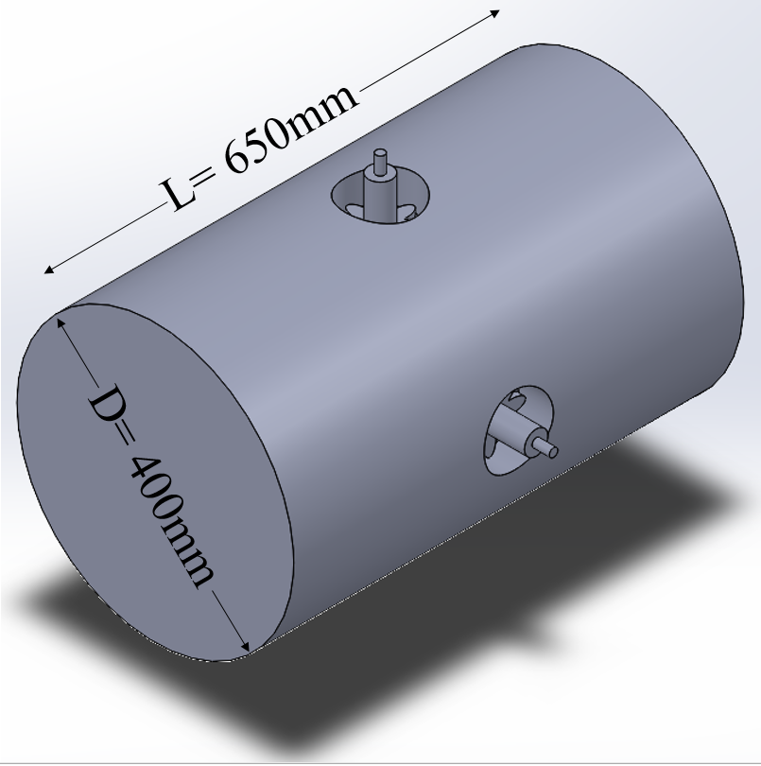
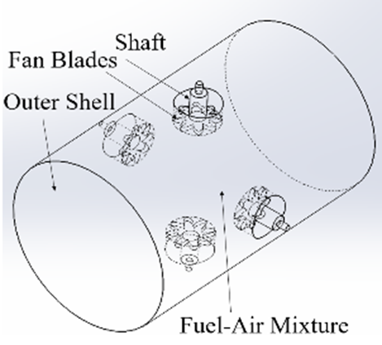
b. Numerical Simulation Approach
Model Description
Zimont Turbulent Flame Speed Closure (Zimont TFC) was implemented into ANSYS Fluent through a RANS approach.
This model assumes an increasing thickness of the flame brush and a constant combustion velocity.
The geometry was designed using SOLIDWORKS and then exported into Fluent for meshing and post-processing.
Dimensions were obtained from experimental measurements.
The model has been validated for use against well-known experimental work (Ravi 2014).
The grid, time step and ignition regions sizes were selected for use after conducting a mesh independency study.
The combustion bomb’s SOLIDWORKS model

Slide 15
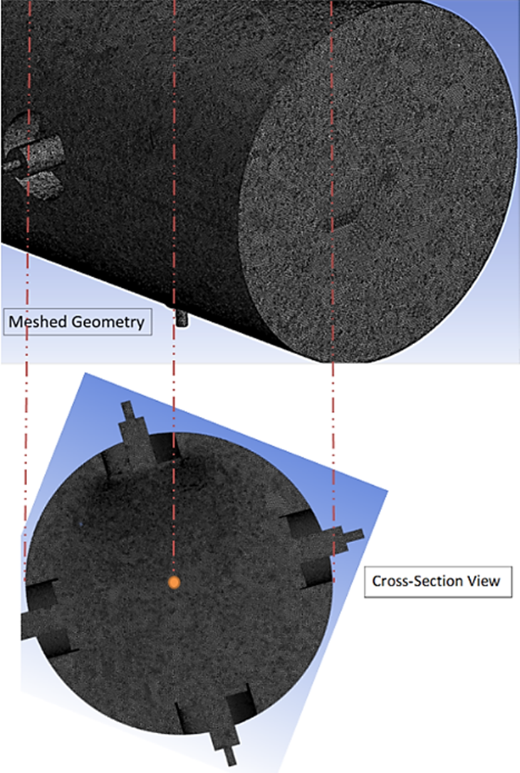
b. Numerical Simulation Approach
Numerical Grid Details
Mesh details and statistics
Parameter | Type (or Value)
Size function | Adaptive
Relevance center | Fine
Smoothing | Medium
Span Angle Center | Fine
Element Size (mm) | 2.00
Inflation Option | Smooth Transition
Nodes | 1422642
Elements | 7844078
Average Element Quality | 0.84
Average Skewness | 0.22
Orthogonal Quality | 0.86
Perspective view of numerical grids on the combustion bomb surface

Slide 16
b. Numerical Simulation Approach
Numerical Model Settings, Discretization and Initialization
Numerical model settings of the spark plug
Solution initialization
Parameter | Type (or Value)
Processor Option | Serial
Solver Type | Pressure-Based
Time | Transient
Discretization | 2nd Order Upwind
Species Model | Premixed Combustion Model
Flame Speed Model | Zimont Model
Viscous Model | K-epsilon, Realizable with Enhanced Wall Treatment
Equivalence Ratio (Ø) | 0.7 to 1.3
Spark Location | At the Center of the Vessel
Spark Energy (mJ) | 40
Spark Duration (s) | 0.0001
Spark’s Transition Radius (mm) | 0.5
Parameter | Type (or Value)
Solution Scheme | Coupled
Solution Initialization | Standard
Initial Pressure (atm) | 1
Initial Temperature (K) | 463
Integral Length Scale, L_{t} (mm) | 20
Reaction Progress Variable, C at t=0s | Zero (at All Zones)
Time Step Size (s) | 0.00025
Number of Time Steps | 120
Maximum Iterations/Time Step | 25

Slide 17
b. Numerical Simulation Approach
Tested Fuels Blends
Properties of diesel, GTL and 50-50 blend
Flames properties of the tested fuels at Ф=1.0
Properties | Diesel | GTL | 50-50 Blend
H/C Ratio | 2.125 | 2.1-2.15 | 2.1-2.125
Approx. Formula | C₁₆H₃₄ | C₁₆H₃₄ | C₁₆H₃₄
Density at 15ºC (kg/m³) | 830 | 770 | 792
Boiling Range (ºC) | 190-360 | 160-360 | 165-360
Flash Point (ºC) | 55 | 77 | 71
Cetane Number | 55 | 75 | 64
Calorific Value (MJ/kg) | 42.9 | 49.3 | 46.2
Fuel | Diesel | GTL | 50-50 Blend
Property | Ф=1.0
Laminar Flame Speed, S_{l} (cm/s) | 80.24 | 85.49 | 81.55
Laminar Flame Thickness, 𝛿_{l} (cm) | 0.034 | 0.033 | 0.033
Density Ratio, σ | 0.194 | 0.186 | 0.190
Reynolds Number, Re | 571.4 | 528.0 | 534.5
Lewis Number, Le | 1.039 | 0.985 | 1.012
* The flame properties were also found at Ф=0.7 and Ф=1.3

Slide 18
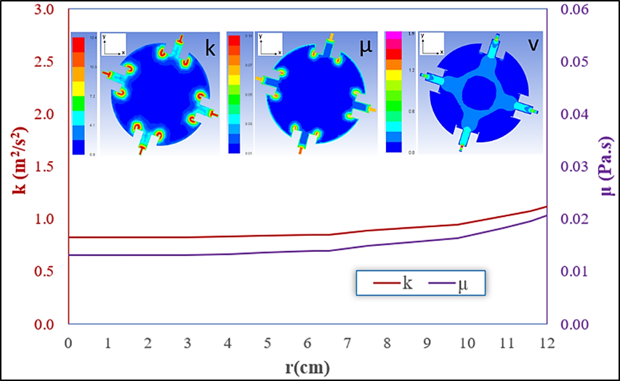
c. Results and Discussions
CFD Results
1) Mean Turbulent Kinetic Energy Balance
Mean turbulent kinetic energy and turbulent eddy viscosity throughout the combustion vessel up to r =12cm, at u`=3.0m/s and Φ=1.0
K and μ reach their maximum value near the mixing fans and start to gradually decrease until reaching their minimum value at the center point of the vessel.
The turbulent flow field was found to be homogenous and isotropic.

Slide 19
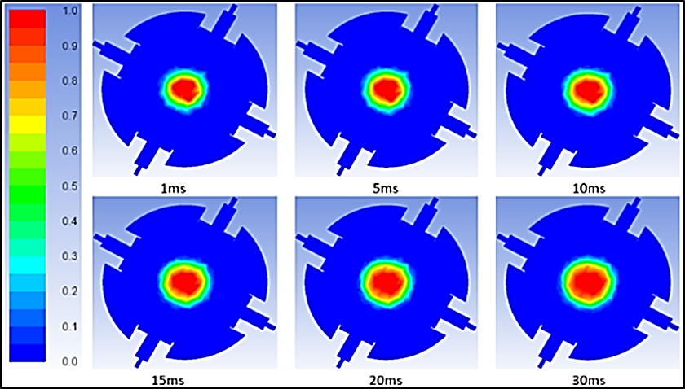
c. Results and Discussions
CFD Results
2) Flame Radius Evolution
Flame radius evolution for stoichiometric GTL-air mixture at 1atm, T_{i} = 463K and u`=3.0m/s
C
For the laminar cases (t < 25ms), the flame radius develops linearly with time. However, for turbulent cases (t > 25ms), the radius grows rapidly and non-linearly with time.
The flame brush is thickening as the flame develops, having islands of burned gases inside it (C=1 in CFD color bar) and unburned gases outside it (C=0 in CFD color bar).

Slide 20
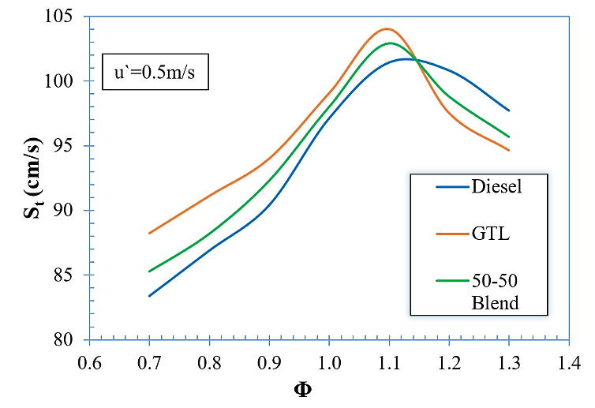
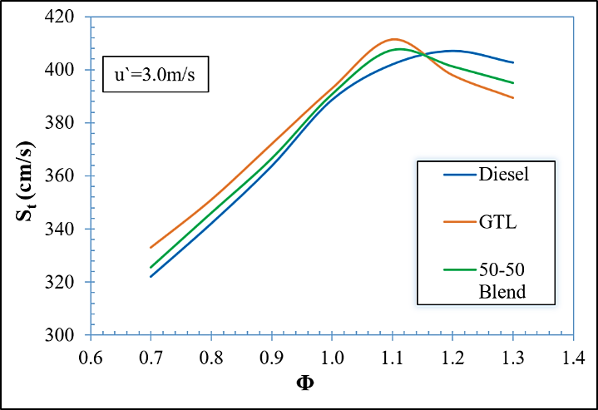
c. Results and Discussions
CFD Results
(a)
3) Turbulent Flame Speeds (S_{t})
All the curves are bell-shaped, and S_{t} reaches it maximum value near stoichiometric condition.
Parameters such as K, µ, S_{t}, Re_{T} and Da were computed at the corresponding r, Ø and u` using ANSYS Fluent and listed in filtered tables for the ease of accessibility.
The use of GTL fuel and the 50/50 blend at has increased S_{t} by around 3.8% and 1.9%, respectively compared to diesel fuel at equivalence ratios less than 1.1 (Ф < 1.1).
(b)
S_{t} versus Ф for the three fuels at T_{i} = 463K and: (a) u`=0.5m/s, (b) u`=3.0m/s

Slide 21
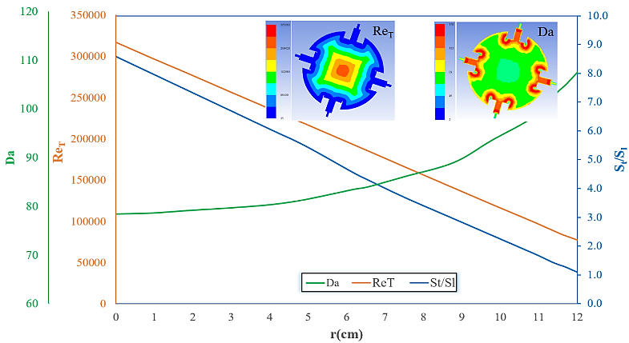
c. Results and Discussions
CFD Results
4) Dimensionless Numbers for Turbulent Combustion
Re_{T} and Da throughout the vessel radius (0 < r < 12cm) for stoichiometric GTL fuel at u`=3.0m/s and t=30ms
Re_{T} peaks at the center of the vessel, as this region is characterized by the lowest turbulent eddy viscosity and turbulent kinetic energy.
Da >1 throughout the flame radius indicates that the chemistry has dominated the turbulence at all regions with different reaction rates.

Slide 22
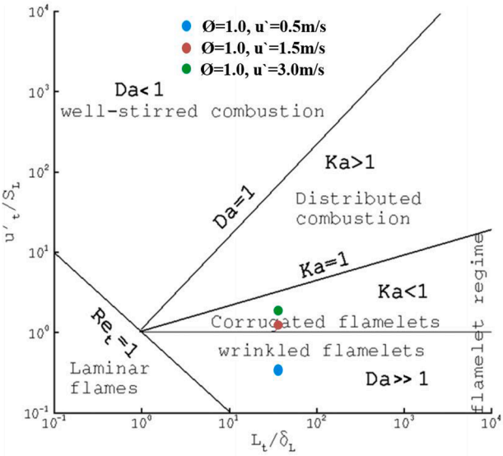
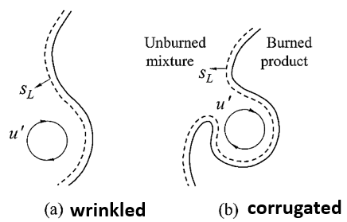
c. Results and Discussions
CFD Results
5) Flame Structure on Borghi Diagram
At a low turbulence intensity level (u`=0.5m/s), the flame morphology is defined by a wrinkled flamelets regime. However, at moderate and higher turbulence levels (u`=1.5m/s and u`=3.0m/s, respectively), the corrugated flamelets regime defines the flame structure.
Determination of stoichiometric GTL fuel combustion regimes at three different turbulence intensities

Slide 23
d. Conclusions
The main findings of this study are:
Transient 3-D numerical investigations were performed to study turbulent flames of three liquid fuel blends (diesel, GTL, 50/50 diesel-GTL blend) using Zimont TFC model.
The existence of HIT condition in the center of the vessel has been verified through studying turbulent kinetic energy balance throughout the vessel.
The rate of flame radius evolution and turbulent flame speeds were found to be higher for lean GTL fuel compared to other fuels due to its lower density ratio and Le < 1.
At the same elapsed time (t = 30 ms), Re_{T} and Da were found to be greater for GTL fuel compared to diesel and 50/50 diesel-GTL blend, which indicates that the flame propagates towards the vessel’s wall at a faster rate and the chemistry has dominated turbulence in a shorter time
In contrast, rich diesel was found to have a faster flame development and higher turbulent flame speeds due to the same reasons.
At low turbulence level (u′ =0.5 m/s), the flame morphology was defined by a wrinkled flamelet regime. However, at moderate and higher turbulence levels (u′ =1.5 m/s and u′ =3.0 m/s), the flame structure was defined by the corrugated flamelets regime.

Slide 24
Thanks for Listening
Q & A

