Slide 1
Interview for Post-Doc Position in IIT
Introduction to my Career and Research Profile
Dr. Abdellatif Sadeq
13/04/2023

Slide 2
Outline
Personal Profile
Education
Research Profile
Plans for Research in IIT
Research in Major Area
Research in Minor Area

Slide 3
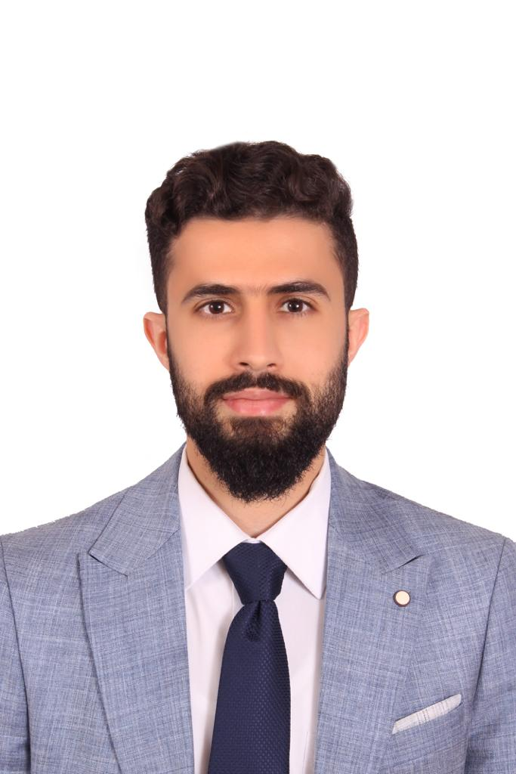
1. Personal Profile
Personal Information
Name: Dr. Abdellatif Mohammad Sadeq
Nationality: Jordanian
Data of Birth: 30/04/1993 (29 y.o.)
Languages: Arabic (Fluent), English (Excellent)
Residency: Jordan (1993 to 1998), Qatar (1998 to 2023)
Status: Single
Phone: +974 33108689
Email: abboud1993@yahoo.com
LinkedIn Profile: Dr. Abdellatif Sadeq
Experience: +8 years in Teaching and Research at QU
Membership: ASHRAE, Review in IMDP, SCI, and QU Alumini
Key Skills
Documentation: MS Word, Excel, PPT, Outlook, Grammarly, iThenticate, and Mendeley
Programming: C++, Python, MATLAB, Arduino, and R
Modeling and Simulation: AutoCAD, SOLIDWORKS, ANSYS Fluent, Mechanical APDL, Simulink, Simscape, CATIA V5, and Mathematica
Energy and Thermodynamic: EES, GASEQ, Thermtest, and Chemkin Pro
Data Analysis: SurveyMonkey, Simplybook, Blue Survey, and Google Form
Personal: Hard-Working, Problem Solving, Teamwork, Planning, and Deep Analysis

Slide 4
2. Education
Scientific Degrees
The General Secondary Education Certificate \ Scientific Section, Ahmed Bin Hanbal Secondary Ind. Boys School Public
2009 September - 2010 July Ranked in the top 10 students list in Qatar
B.Sc. in Mechanical Engineering, Qatar University
2011 February - 2015 January Awarded 7 distinction certificates (CGPA of 3.59/4.00)
M.Sc. in Mechanical Engineering, Qatar University
2015 September - 2018 January Awarded 4 honor certificates (CGPA of 3.68/4.00)
Ph.D. in Mechanical Engineering, Qatar University
2018 August - 2022 May Excellency Certificate in Ph.D. Program (CGPA of 3.77/4.00)
About to Receive a Second Master Degree in Hybrid and Electric Vehicles Design and Analysis
End of June

Slide 5
3. Research Profile
Profile
ResearchGate: https://www.researchgate.net/profile/Abdellatif-Sadeq
ORCID iD: 0000-0002-1825-0304
Google Scholar: https://scholar.google.com/citations?hl=en&user=dkkLKo0AAAAJ
Areas of Expertise:
Major Areas i) Internal combustion engines, ii) Premixed turbulent combustion, iii) Alternative fuels, iv) Fuel technology, v) Turbulence modelling, vi) EV/HEV vehicles design and analysis, vii) Heat transfer
Minor Areas
i) Hydrogen production and combustion, ii) Renewable energy utilization, iii) Sustainable development, iv) HVAC

Slide 6
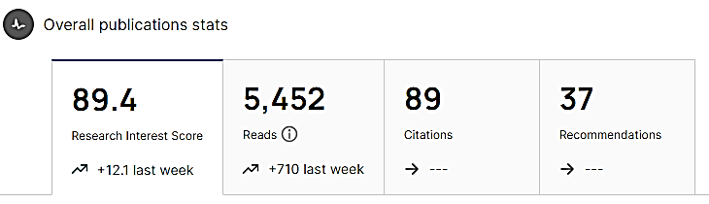
3. Research Profile
Profile
Statistics:
13 journal papers, 6 published, 4 under review and 3 under preparation
4 conference papers
19 projects, 2 books, 1 user manual, 1 method, 1 seminar, M.Sc. thesis and Ph.D. dissertation
as recorded in ResearchGate on 13/04/2023

Slide 7
3. Research Profile
a) Research in Major Area
1) A. M. Sadeq, S. F. Ahmed, and A. K. Sleiti, “Transient 3D simulations of turbulent premixed flames of gas-to-liquid (GTL) fuel in a fan-stirred combustion vessel,” Fuel, vol. 291, no. February, p. 120184, 2021, doi: 10.1016/j.fuel.2021.120184. May 2021 Q1 6.609
Problem Definition: determine the suitability of replacing the use of diesel fuel by GTL, and 50/50 diesel/GTL blend by numerically studying the premixed turbulent combustion of the these three fuels.
Objectives: numerically study the premixed turbulent combustionof GTL fuel and 50/50 diesel-GTL blend and compare them to diesel under a wide range of equivalence ratio (0.7 < Ф < 1.3) and turbulence intensities (0.5 m/s < u′ < 3.0 m/ s) using Zimont Turbulent Flame Speed Closure (Zimont TFC) model
Key Research Outcomes:
Rich diesel and lean GTL fuels are characterized by higher turbulent flame speeds
Re_{T} and Da are found to be greater for stoichiometric GTL fuel at t=30ms
Wrinkled flamelet in Borghi diagram at u`=0.5m/s, and corrugated u`=1.5m/s, 3.0m/s
Contribution: literature review, developing CFD code, modelling, analysis, data handling, results and discussions, and conclusions

Slide 8
3. Research Profile
a) Research in Major Area
2) A. M. Sadiq, A. K. Sleiti, and S. F. Ahmed, “Turbulent Flames in Enclosed Combustion Chambers: Characteristics and Visualization—A Review,” J. Energy Resour. Technol., vol. 142, no. 8, 2020, doi: 10.1115/1.4046460. February 2020 Q2 IF: 3.09
Problem Definition: overview the significant issues associated with the use of fan-stirred combustion bombs
Objectives: 1) review the effect of varying fan speed and geometry, and study the measurement techniques for measuring flame speed, 2)study of the effect of using different types of fuels on combustion characteristics, 3) review the use of diesel and gasoline optical engine setups as advanced flame visualization tools.
Key Research Outcomes:
Fan-stirred combustion bomb is the most widely used configuration
Easy-control of the initial temperature, pressure, and turbulent intensity
Schlieren imaging is the most widely used
Optical engines were used to study ignition delay time, in-cylinder pressure, flame visualization and heat release rate for a number of heavy diesel fuels
Contribution: review all the past researchers and then thoroughly write the review paper

Slide 9
3. Research Profile
a) Research in Major Area
3) A. M. Sadeq, M. A. Bassiony, A. M. Elbashir, S. F. Ahmed, and M. Khraisheh, “Combustion and emissions of a diesel engine utilizing novel intake manifold designs and running on alternative fuels,” Fuel, vol. 255, no. July, p. 115769, 2019, doi: 10.1016/j.fuel.2019.115769.
July 2019 Q1 IF: 6.609
Problem Definition: enhancing the performance of the diesel engine and reduce subsequent associated emissions.
Objectives: Three novel spiral-helical shaped intake manifolds with varying helical diameter and designs (1D, 2D, 3D) were tested using a number of alternative fuels including Gas-to-Liquid (GTL) fuel, waste cooking oil, biodiesel and corn oil, in addition to blends of these fuels with conventional diesel.
Key Research Outcomes:
Manifold design (1D) exhibited superior improvements in engine performance and marked reduction in emissions irrespective of the fuel type
For high cetane-number (CN) fuels (such as GTL), a marked reduction in the pressure raise rate (dP/dθ) and the peak pressure inside the cylinder was observed
47% reduction in NOx and 32% in PM emissions at part load compared to diesel
Contribution: literature review, conduct experimental work, calculations and results

Slide 10
3. Research Profile
a) Research in Major Area
4) S. Samim, A. M. Sadeq, and S. F. Ahmed, “Measurements of Laminar Flame Speeds of Gas-to-Liquid-Diesel Fuel Blends,” J. Energy Resour. Technol. Trans. ASME, vol. 138, no. 5, pp. 1–8, 2016, doi: 10.1115/1.4033627. May 2016 Q2 IF: 3.09
Problem Definition: reduce emission and global warming effects by looking for GTL and 50-50% diesel/GTL blend as an alterative fuel to diesel
Objectives: Measure the laminar flame speed, S_{N} , of gas-to-liquid (GTL) fuel and its 50–50% by volume blends with conventional diesel, in a cylindrical bomb capable of measuring S_{N} at different initial temperatures and equivalence ratios at ambient pressure
Key Research Outcomes:
Pure GTL fuel has the highest S_{N} near stoichiometric conditions, which is about 88.3 cm/s
The blended fuel has the lowest S_{N} at lean and rich mixture conditions
Studying the effect of increasing the initial temperature on S_{N} revealed that S_{N} of the three tested fuels increases with the increase in the initial temperature almost linearly
Contribution: experimental setup and work

Slide 11
3. Research Profile
a) Research in Major Area
5) Experimental Measurements and Transient 3D Simulations of Turbulent Premixed Flames of Gas-to-liquids (GTL) Fuel in a Fan-Stirred Combustion Bomb Ph.D. Dissertation 2022
Problem Definition: The rapid fluctuation in oil prices and the increased demand for alternative fuels to replace conventional fuels are challenging. GTL detailed combustion characteristic investigations are required before replacement to diesel.
Objectives: Experimentally and numerically investigate GTL (and its 50/50 by volume blend with diesel) turbulent flame speeds (S_{t}) under a wide range of thermodynamics and turbulence operating conditions using a cylindrical fan-stirred combustion bomb.
Key Research Outcomes:
The use of stoichiometric GTL fuel and 50/50 diesel-GTL blend has decreased the combustion peak pressure by 8.9% and 4.9%, respectively, compared to diesel fuel
Rich diesel and lean GTL fuels were characterized by a faster flame radius evolution, a higher pressure rise rate (dp/dt)
The CFD results were found to be in excellent agreement with the experimental measurements at u`=2.0m/s, where the absolute error percentage (ε_{a}= 0.65%).
Contribution: conducting and writing all the dissertation sections

Slide 12
3. Research Profile
a) Research in Major Area
6) Development of Machine Learning Models for Studying the Premixed Turbulent Combustion of Gas-To-Liquids (GTL) Fuel Blends Article (Under Review) 2023
Problem Definition: Studying a particular fuel's premixed turbulent combustion is important for controlling the combustion processes in applications such as internal combustion engines and gas turbines.
Objectives: Based on previous 3D numerical analyses, this study aims to develop data-driven Machine Learning (ML) models for predicting the flame radius evolution and turbulent flame speeds for diesel, GTL, and their 50/50 blend under different operating conditions.
Key Research Outcomes:
(i) Two ML models were developed. Model 1 predicts the variations of the turbulent flame radius with respect to the equivalence ratio and time, whereas model 2 predicts the turbulent flame speed variations with respect to the equivalence ratio, turbulence intensity, and vessel radius
(ii) Good agreement between model 1, 2 and CFD, where max ε_{a}= 6.58%
Contribution: literature review, importing and developing the dataset from ANSYS Fluent, building relations between dependent and independent parameters.

Slide 13
3. Research Profile
a) Research in Major Area
7) Development of a Forward Energy-Based Fuel Consumption Model of a P1 Hybrid Vehicle Project 2023
Problem Definition: quantify the improvement in fuel economy numbers for the hybrid vehicle (kmpl), compared to the conventional vehicle, on the urban cycle (UDDS) and highway cycle (HWFET).
Objectives: use MATLAB and Simulink to analyze and understand the vehicle operating points in terms of engine and motor speed, torque, transmission speeds, pedal positions, gear, distance traveled, battery voltage, current, SoC, and fuel economy numbers.
Key Research Outcomes:
The fuel economy number is higher for HWFET drive cycle compared to UDDS, due to less power loss. Even though, the lost power will be recaptured by regenerative braking, and thus increases battery SoC,
Due to more brake pedal engagement and idle time during the UDDS drive cycle, city fuel economy number is significantly lower than in highway
Contribution: programming in MATLAB, building Simulink model, data gathering and analysis, results and discussions, and writing detailed report.

Slide 14
3. Research Profile
a) Research in Major Area
1) Transient 3D Simulation of Turbulent Premixed Combustion of Different Hydrogen Surrogates in a Fan-Stirred Combustion Bomb [Article - Under Preparation] To be submitted on April 2023
2) Experimental Study of Turbulent Premixed Flames of Gas-to-Liquid (GTL) Fuel in a Fan-Stirred Combustion Bomb [Article - Under Review]
Submitted on June 2022
3) Development of a Forward Energy-Based Fuel Consumption Model for a Conventional Vehicle [Project]
4) Analysis of a Practical Automotive Wiring Circuit [Project]
5) CFD Analysis of a Simple Carburetor Using Modified Aerodynamic Shape Throttle Plate Valves [Project]
6) Development of Local Biofuels for Better Performance and Emissions Diesel Engines [Project]

Slide 15
3. Research Profile
b) Research in Minor Area
1) Effect of Using louvered Strip Insert and Nanofluid Flow in Backward-Facing Step on Heat Transfer Improvement [Article - Under Preparation]
To be submitted on April 2023
2) Prediction of Effects of Louvered Strip Insert and Nanofluid Flow in Forward-Facing Reducing Channel on Thermal Performance Ribs [Article - Under Preparation]
To be submitted on April 2023
3) Comparative Study on Heat Transfer Improvement of Nanofluids Flow in Forward-Facing Reducing Channel with and without Novel Hybrid Ribs [Article - Under Review]
Submitted on March 2023
4) Machine Learning Assisted Simulation and Optimization of TEG Regeneration in Natural Gas Dehydration Process [Article - Under Review]
Submitted on February 2023

Slide 16
3. Research Profile
b) Research in Minor Area
5) Thermo-Mechanical Refrigeration System [Conference Paper]
6) Toward 3D Printed Prosthetic Hands that Can Satisfy Psychosocial Needs: Grasping Force Comparisons between a Prosthetic Hand and Human Hands [Conference Paper]
7) Development of a Double-Acting Actuator Model Using Simscape Multibody and Simscape Components [Project]
8) Position Control of a Mass Spring Damper System [Project]
9) Scope-based Carbon Footprint Analysis of RAA Stadium-Case Study [Project]
10) Stress Analysis in Truss Members Using FEM [Project]
11) Ventilation Chimney for Tall Building Using Solar Updraft Tower (SUT) [Project]
12) Design of Remotely Operated Submarine Vehicles [Project]
13) Introduction to MATLAB for Engineering Students-Level I & II [2 Books]

Slide 17
4. Plans for Research at IIT
My Vision and Mission
Use my technical and software skills, knowledge and research expertise in the field to conduct experimental work and numerical studies in the common areas with Dr. Sudarshan Kumar.
Plans for Research and Innovation
perform numerical modelling and simulation for a set of selected alternative fuels using ANSYS Fluent (Ethyl Estate and Methane)
expand the scope of research for some publications to include the measurement/computation of turbulent flame speeds
develop machine learning models using the datasets obtained from the previously published works (if available)
write and publish review articles about the most important topics in the field
Repeat some studies, but using different measurement techniques

Slide 18
Thanks for Listening
Q & A

