Slide 1
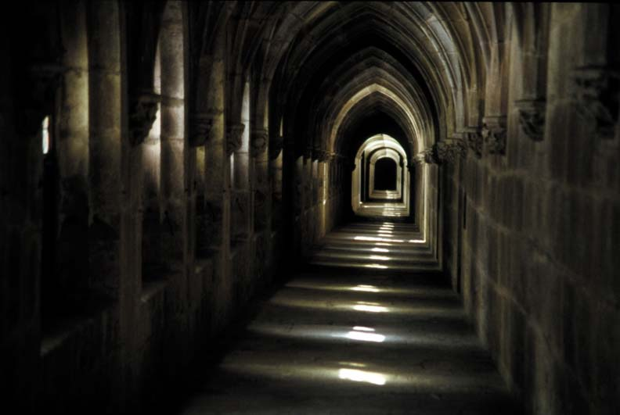
Escape Room Dallas
Let’s Escape DFW in Dallas Fort Worth is the most innovative and unique escape room experience that you can find in the DFW metroplex. The passion that we have for making games, playing games and experiencing them for ourselves is the driving force that has motivated us to open a truly special and one of a kind experience for the enjoyment of our friends and families from all across the Dallas Fort Worth Metroplex.

Slide 2

Escape Room Fort Worth
Our escape room is the right place to enjoy your time, hang out and have some fun. whether for special parties or occasion, or you just want to have a regular place where you can have fun and relax. We provide immersive live interactive experience which is unique and different than most forms of entertainment. We are the perfect place for birthdays, special occasions, school outings, regular hang outs, night out on the town, just friends having a good time, date nights, college nights. Basically, we are great for anyone wanting a unique, different, interactive and fun experience.

Slide 3

Escape Room Southlake
Experience unique live fully immersive entertainment.
Team building through collaborative teamwork.

Slide 4
Escape Room Plano
In order to have a memorable experience the key is to have good communication, involving the whole group for excellent teamwork, using the right people for the right role, and the last one is you have to have good time management skills, you have to use your available time wisely.

Slide 5

Escape Room Dallas
Our escape room experience is also a great tool for practical business and work-related applications. We provide business clients with exercises, games and team building experiences that requires teamwork, collective group thinking, clear group communication, solving problems as a team all done in a fun, engaging and enjoyable environment. Our services help in furthering group cohesion, a sense of belonging working and achieving as a team in the process coming together as a more tight knit effective team that translates over into the workplace.

Slide 6

Escape Room Fort Worth
As natives of Dallas Fort Worth, our biggest pleasure is to offer to everyone here in DFW metroplex to enjoy the fruits of our labor and to have a good time they can remember for the rest of their lives and be assured that it is available to them right here at home in DFW.

Slide 7

Escape Room Southlake
So, we've got this part all cleared up: in every room escape game there is a locked room you have to figure out how to escape from. Their second major characteristic is that the room is always filled with hidden clues on how you could find your way out. Scan everything, don't spare any object you can find in your room. You can also rely on your mouse to highlight the objects on the screen or move around the room.

Slide 8
Escape Room Plano
Room escape games focus on increasing cooperation and building a team spirit where the individual does not limit his duties to individual performance. If used in the right manner, escape room games can help you build a team that work as a cohesive force and solve any business problem in a rational manner.

Slide 9

Escape Room Dallas
Having fun and at the same time putting our minds to a test, what a genial idea! In fact, that's exactly what you get when you play room escape games: some minutes of really relaxing good time and a great intelligence test. Therefore, get ready to trans-pass the borders between the real and the online world and to put all your senses to work, for you've just been locked in a room apparently impossible to escape from!

Slide 10





www.letsescapedfw.com
Visit our website:-
Escape Room Dallas

