Slide 1
The essential benefit of using an airsoft sniper rifle

Slide 2
If you have played the airsoft game earlier, then some of you might know that there are different kinds of firearms are used for different uses. There are the various mechanisms used in different types of guns like some guns use spring, and some use gas while others are electric.
Click site Gearup Sniper Rifles Canada

Slide 3
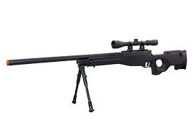

Slide 4
On the other hand, if you are in search of the weapon that can shoot long-range targets, then airsoft sniper rifles will be the perfect option for you.
The sniper rifle is designed to shoot the targets that are far away from you, and also, on the other hand, it is made up of strong components so that it can fire the bullet far away.

Slide 5
The essential benefit of using an airsoft sniper rifle
If we talk about sports airsoft, then there are many kinds of games played under this sport. There are many targets or the people in which we have to shoot them down to win the game. If the target is far away from you, then you should choose an airsoft sniper rifle as it is capable of shooting down the targets that are far away from you.
On the other hand, there is a scope attached to it that can help to view the targets far away so that you can shot them down. This is the topmost reason due to which people choose sniper rifles, and the effect of fire is far higher than any other gun.

Slide 6
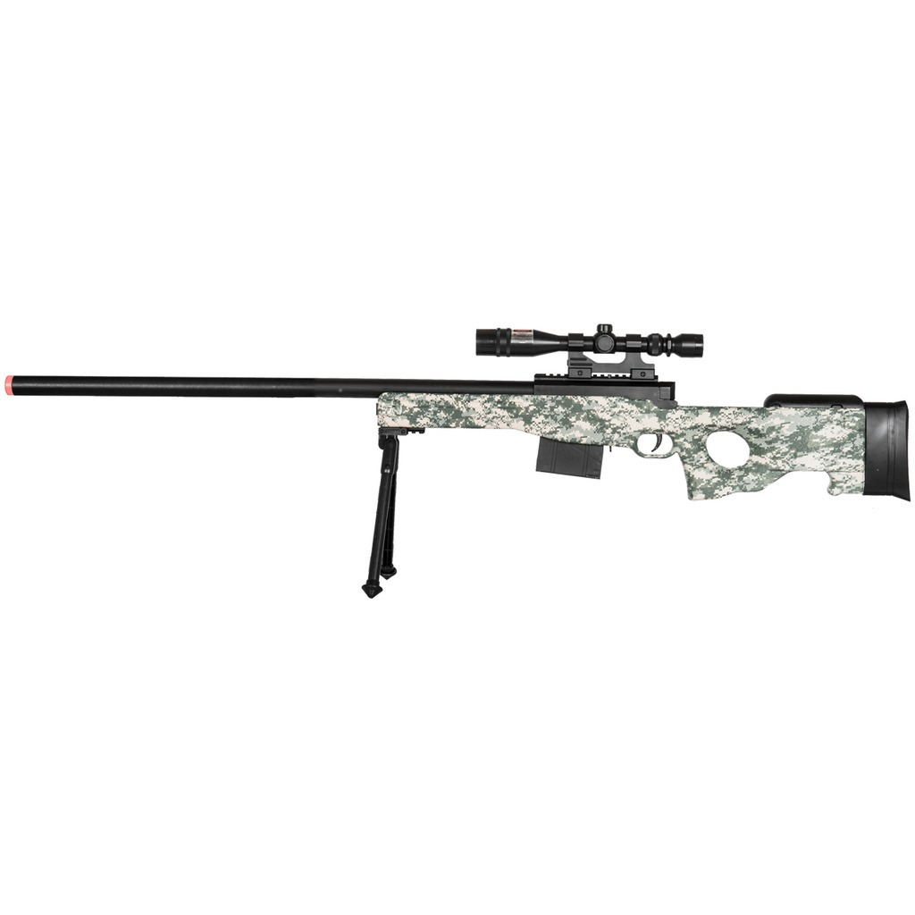

Slide 7
Upgrade your team with a sniper rifle
You should train with a sniper rifle so that you can master in shooting down the enemies. Training is a must if you want to play this kind of sport or game so that you can come to know every essential thing about this game.
Sniper rifle is not easy to operate as you should know how to be stable at the time of aiming so that you can shot the targets down.

